Slide 1
Rapid Detection of Subtle Visual Deficits Using QuickCSF
Group：Deepsick
Kaicheng Yan Linchen Cai
Tianqi Wang Shunyu E

Slide 2
CONTENTS
01
Background
02
Workflow
03
Experimental Analysis
04
Future Outlook

Slide 3
01
Background

Slide 4
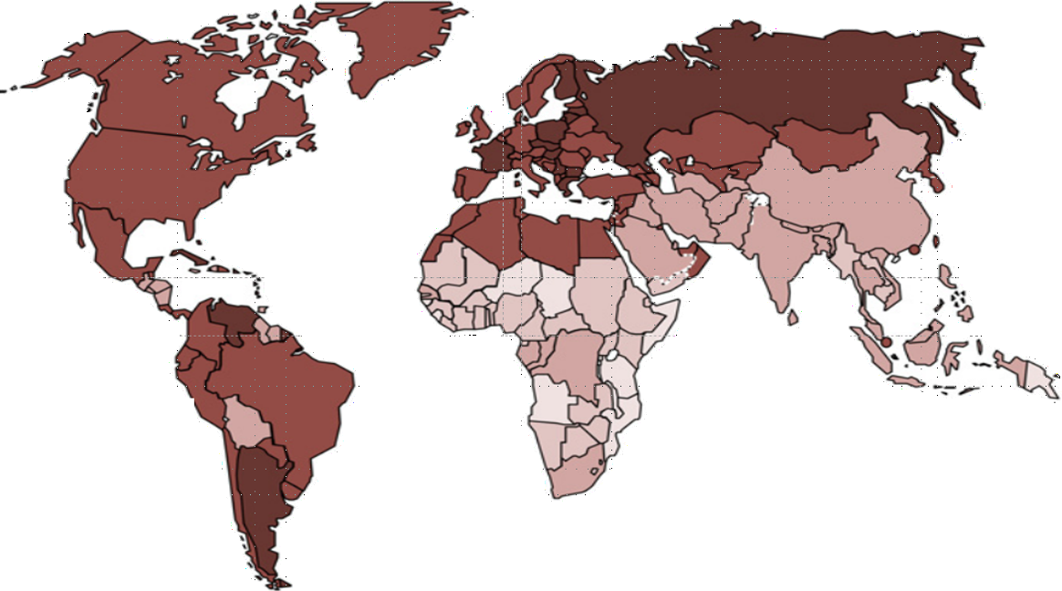
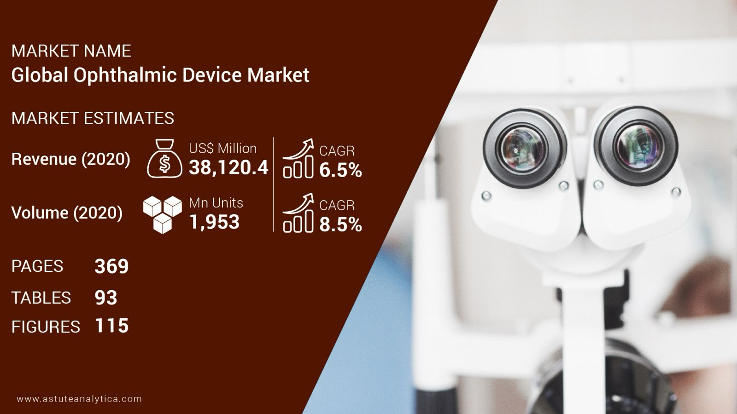
Industry Pain Points: China faces a severe shortage of ophthalmologists (only 1/3 of developed countries) and a long training cycle, leading to a mismatch between diagnosis/treatment needs and resources.
Market Opportunity: The ophthalmic AI device market is expected to reach $37.09 billion in 2022 (CAGR 5.8%), with AI penetration projected to exceed 50% by 2025.

Slide 5
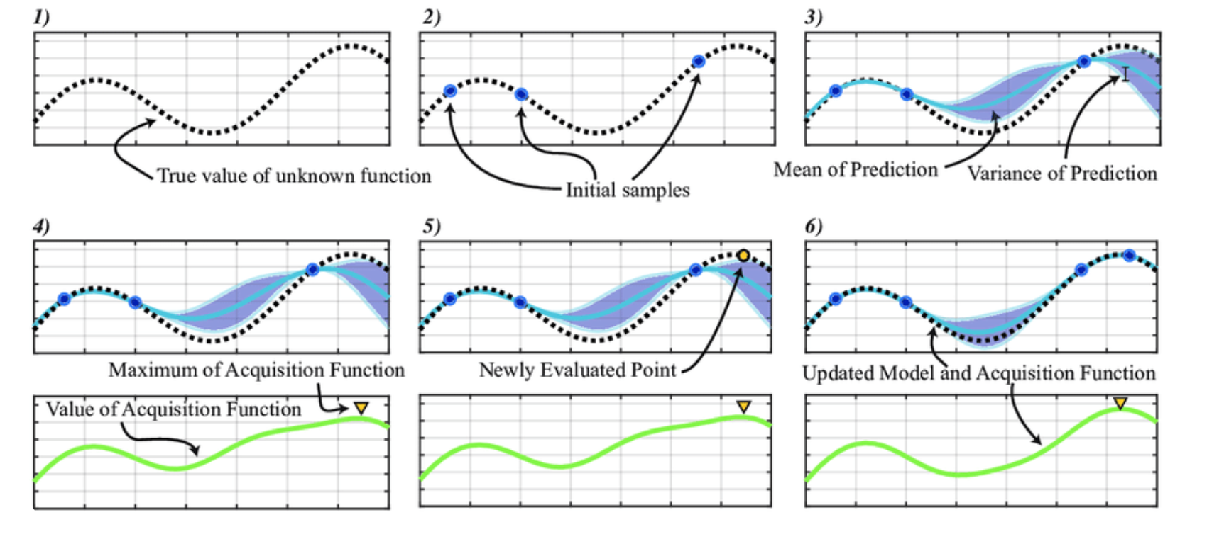
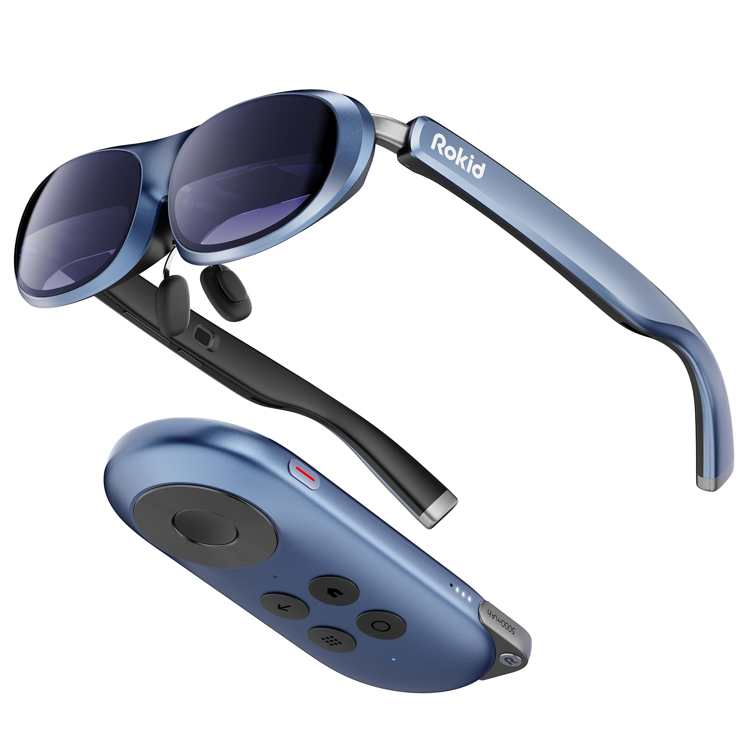
Technical Breakthrough: The original GSLA Bayesian active learning algorithm focuses on visual function detection (e.g., visual field/contrast sensitivity),
integrating imaging devices for combined structural and functional diagnosis.
Product Advantages: Clinically validated prototypes, combined with VR and portable technologies, enhance usability and diagnostic efficiency.

Slide 6
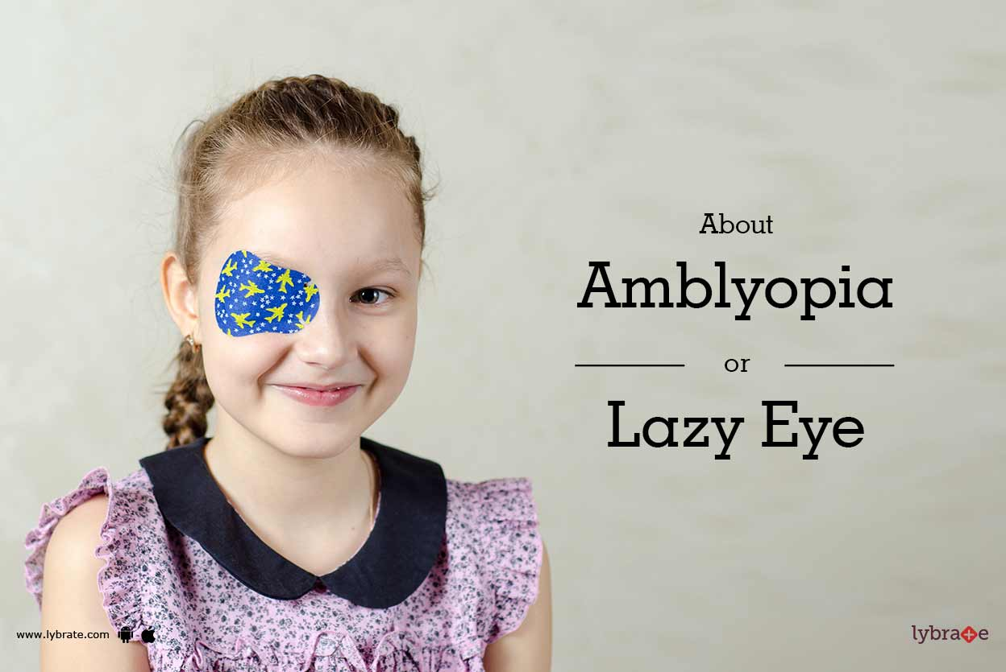
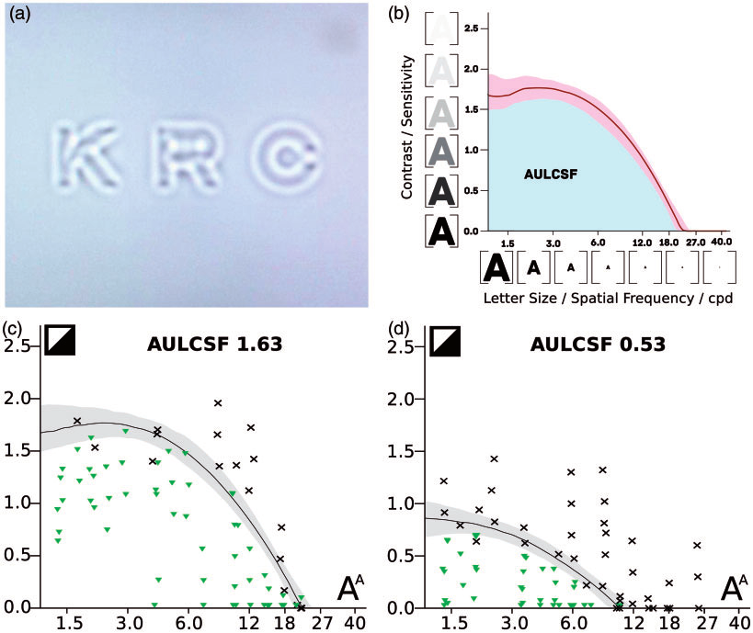
According to the “World Report on Vision” released by the World Health Organization (WHO) in 2019, the global number of people with vision impairment exceeds 2.2 billion. Among them, at least 1 billion individuals could have prevented or treated their conditions through early diagnosis and medical intervention. The patient population includes nearly 400 million with cataracts, 196 million with age-related macular degeneration, 146 million with diabetic retinopathy, 76 million with glaucoma, 2.5 million with trachomatous trichiasis, as well as those suffering from near and far visual impairment or blindness due to uncorrected refractive errors. The degree of visual system impairment relies on visual function measurements.
Contrast Sensitivity Measurement

Slide 7
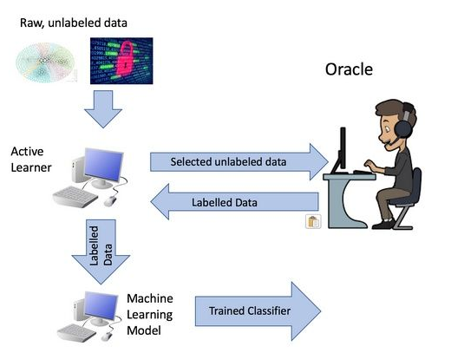

An ophthalmologist diagnoses a patient.
Active Machine Learning Algorithms
Unknown visual function impairment
Unknown visual function impairment
Patient
Patient
doctor
doctor
Diagnosis result
Diagnosis result
Active learning algorithms can be used to accurately and quickly measure visual function impairment, which greatly improves the diagnostic efficiency.

Slide 8
02
Workflow

Slide 9
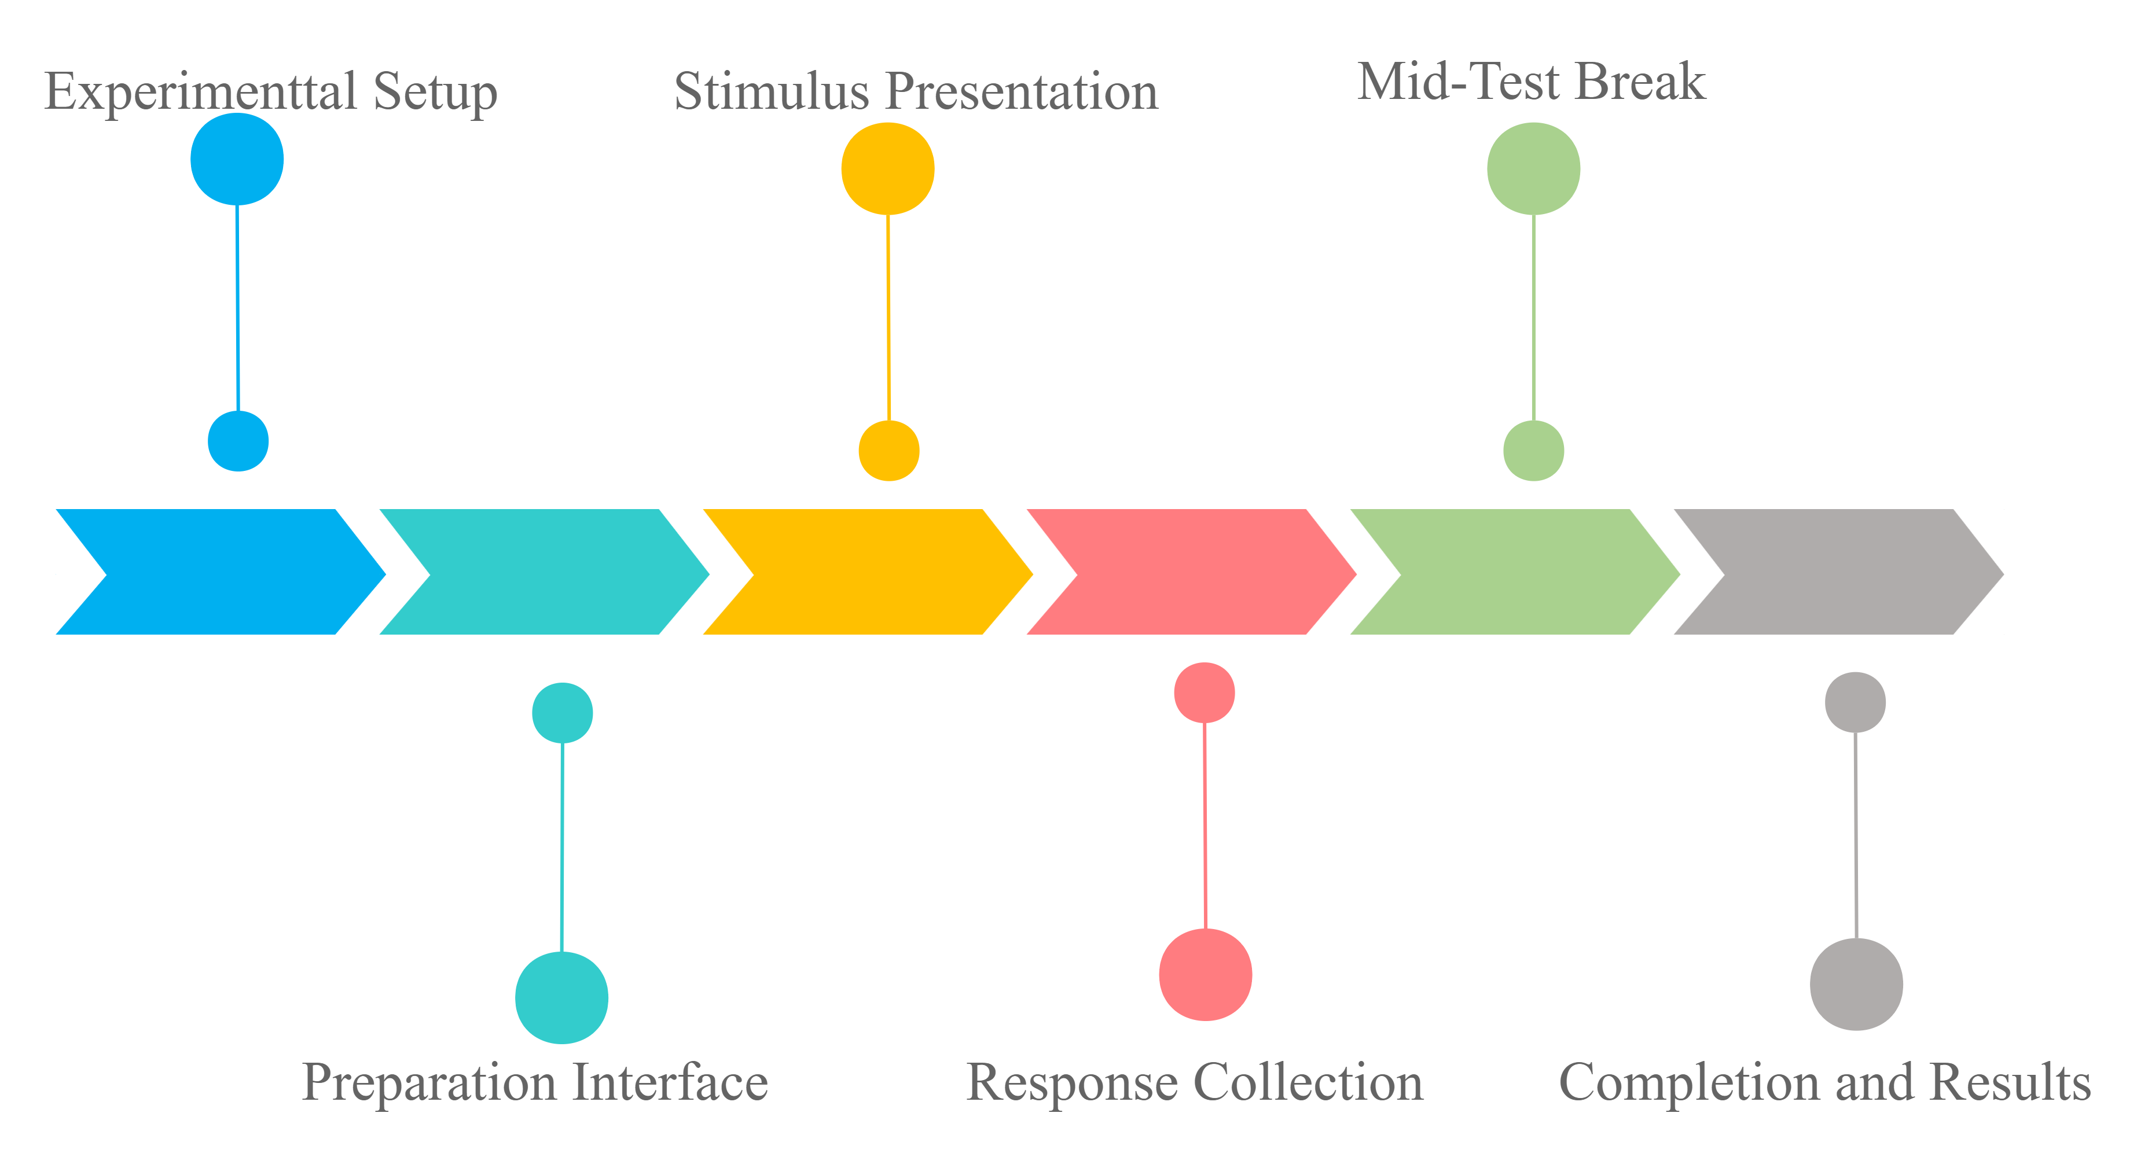
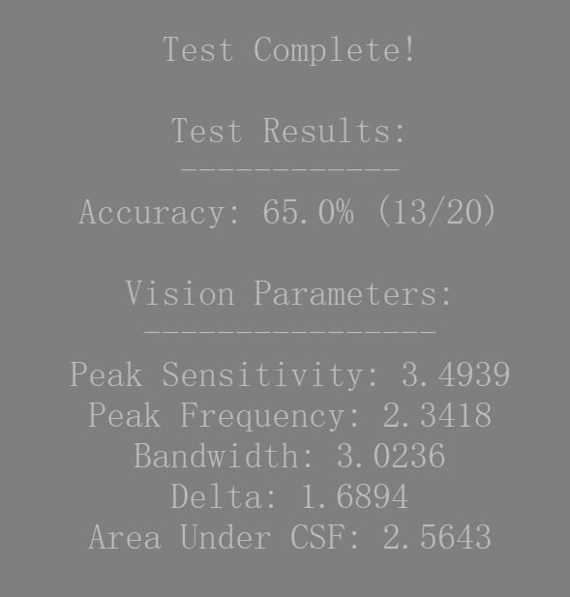
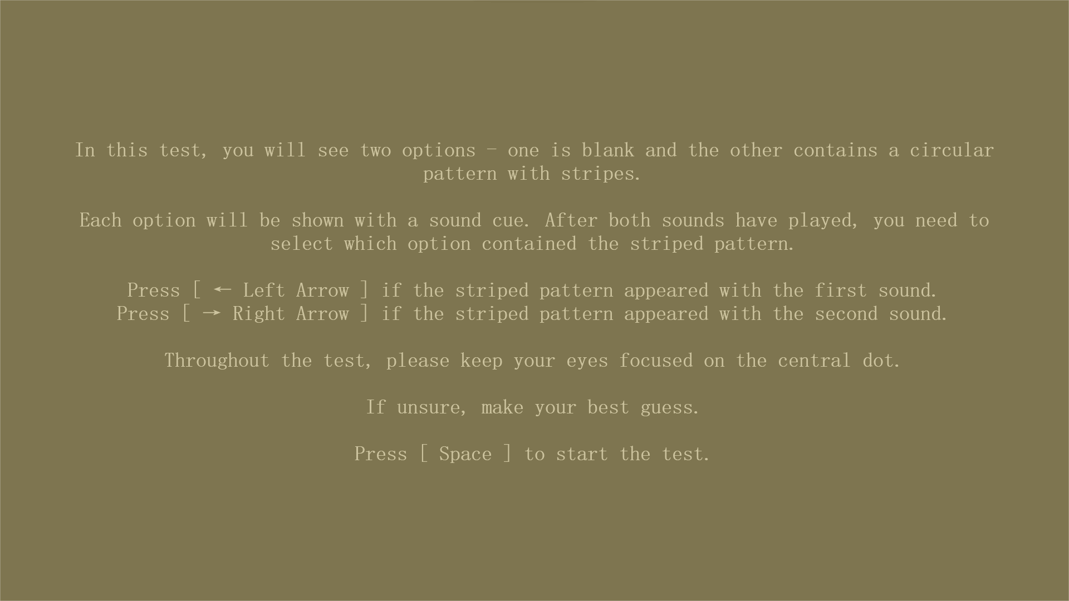
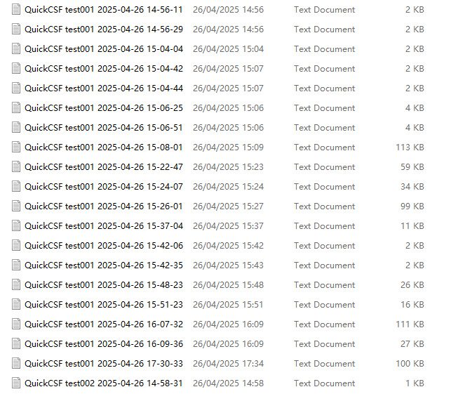
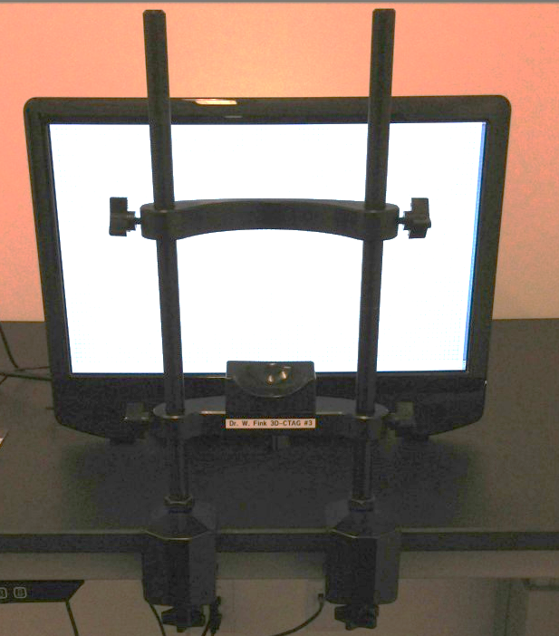

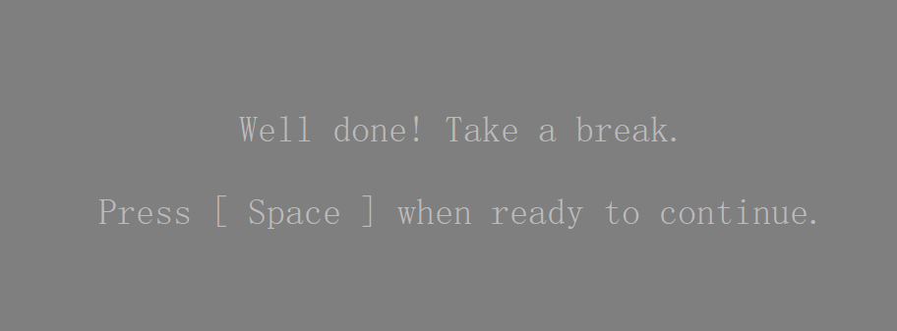
Experimental Setup

Slide 10
03
Experimental Analysis

Slide 11
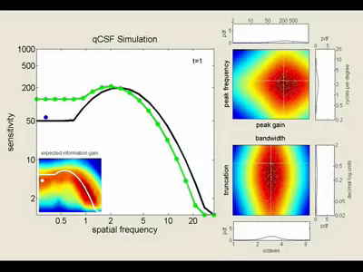

Contrast Sensitivity Function Measurement (qCSF)
Stimulus
Result

Slide 12
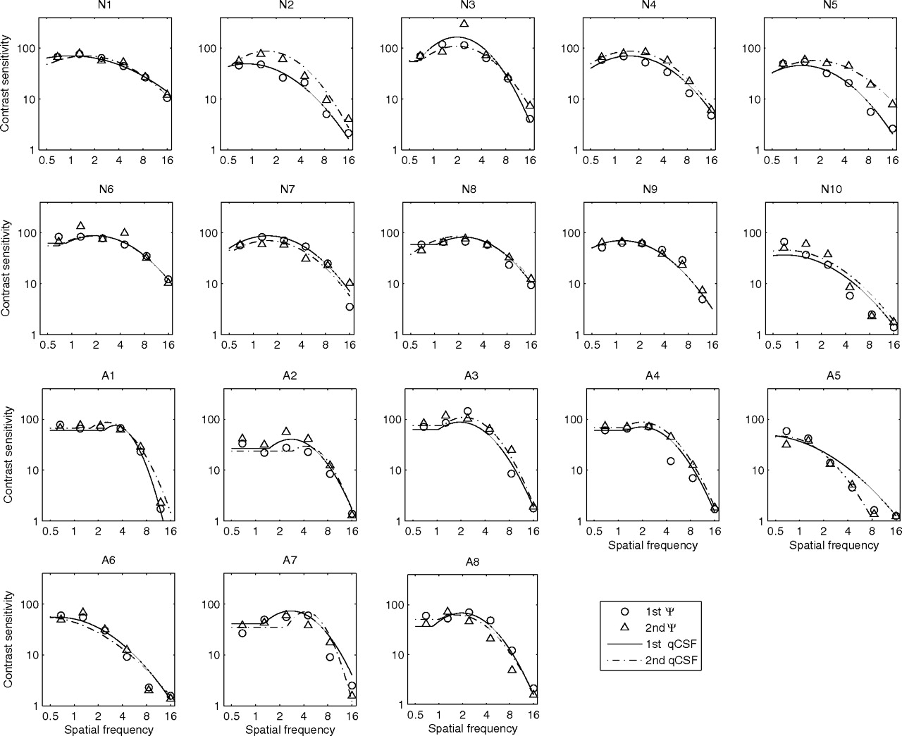
Contrast Sensitivity Measurement: Testing for Amblyopia Patients

Slide 13
Combined Contrast Sensitivity and Visual Field Measurement: Testing for Amblyopia Patients

Slide 14
04
Future Outlook

Slide 15
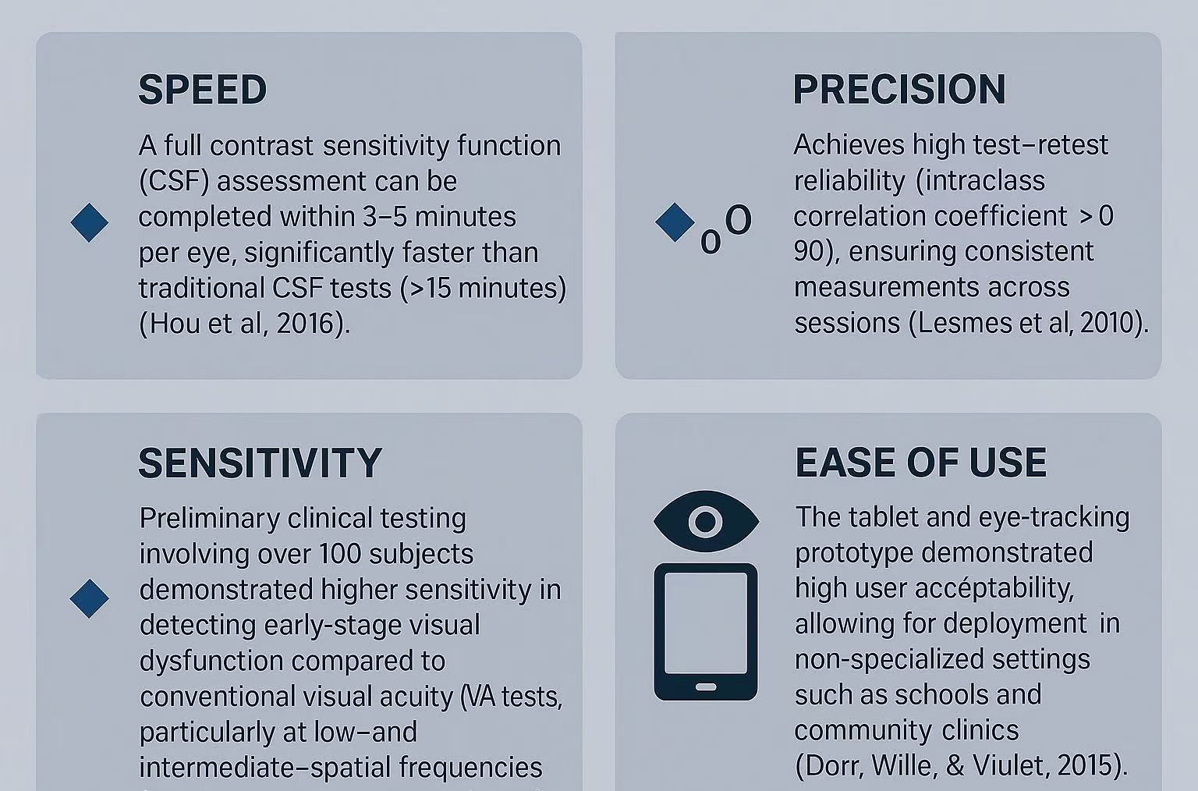
Advantages

Slide 16
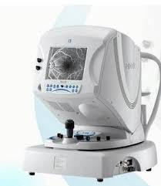
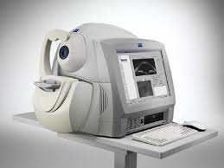

Application Prospects of qCSF Visual Function Measurement System
1. Multimodal Integration with Ophthalmic Imaging
Combine qCSF with FC, OCT, SLO
Enable simultaneous structural (imaging) + functional (CSF) eye assessments
Reduce diagnostic errors from cross-system variability
2. Portable & User-Friendly Technology Upgrades
Integrate with tablets, VR headsets, eye-tracking systems
Enhance accessibility, portability, and scalability of visual function screening
Support deployment in hospitals, primary care centers, and community health programs

Slide 17
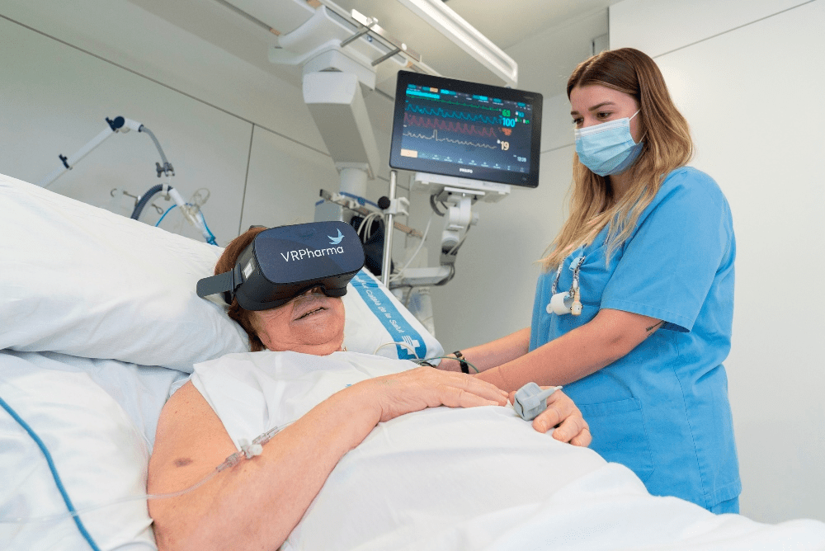
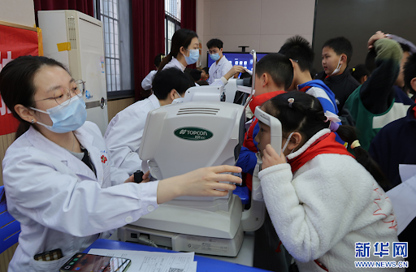
Future Application Directions
Hospital and Primary Care Check-Ups
Integrate the amblyopia screening system into routine health examinations in hospitals and community clinics.
Enable early detection of visual function impairments during general physical assessments.
School-Based Vision Screening
Deploy the system in school vision programs to systematically identify amblyopia and other early-stage visual disorders among children.
Support timely referral for professional ophthalmologic evaluation and intervention.

Slide 18
THANKS

